Slide 1

Bilqis Lawal
My Journey towards being a Data Analyst

Slide 2
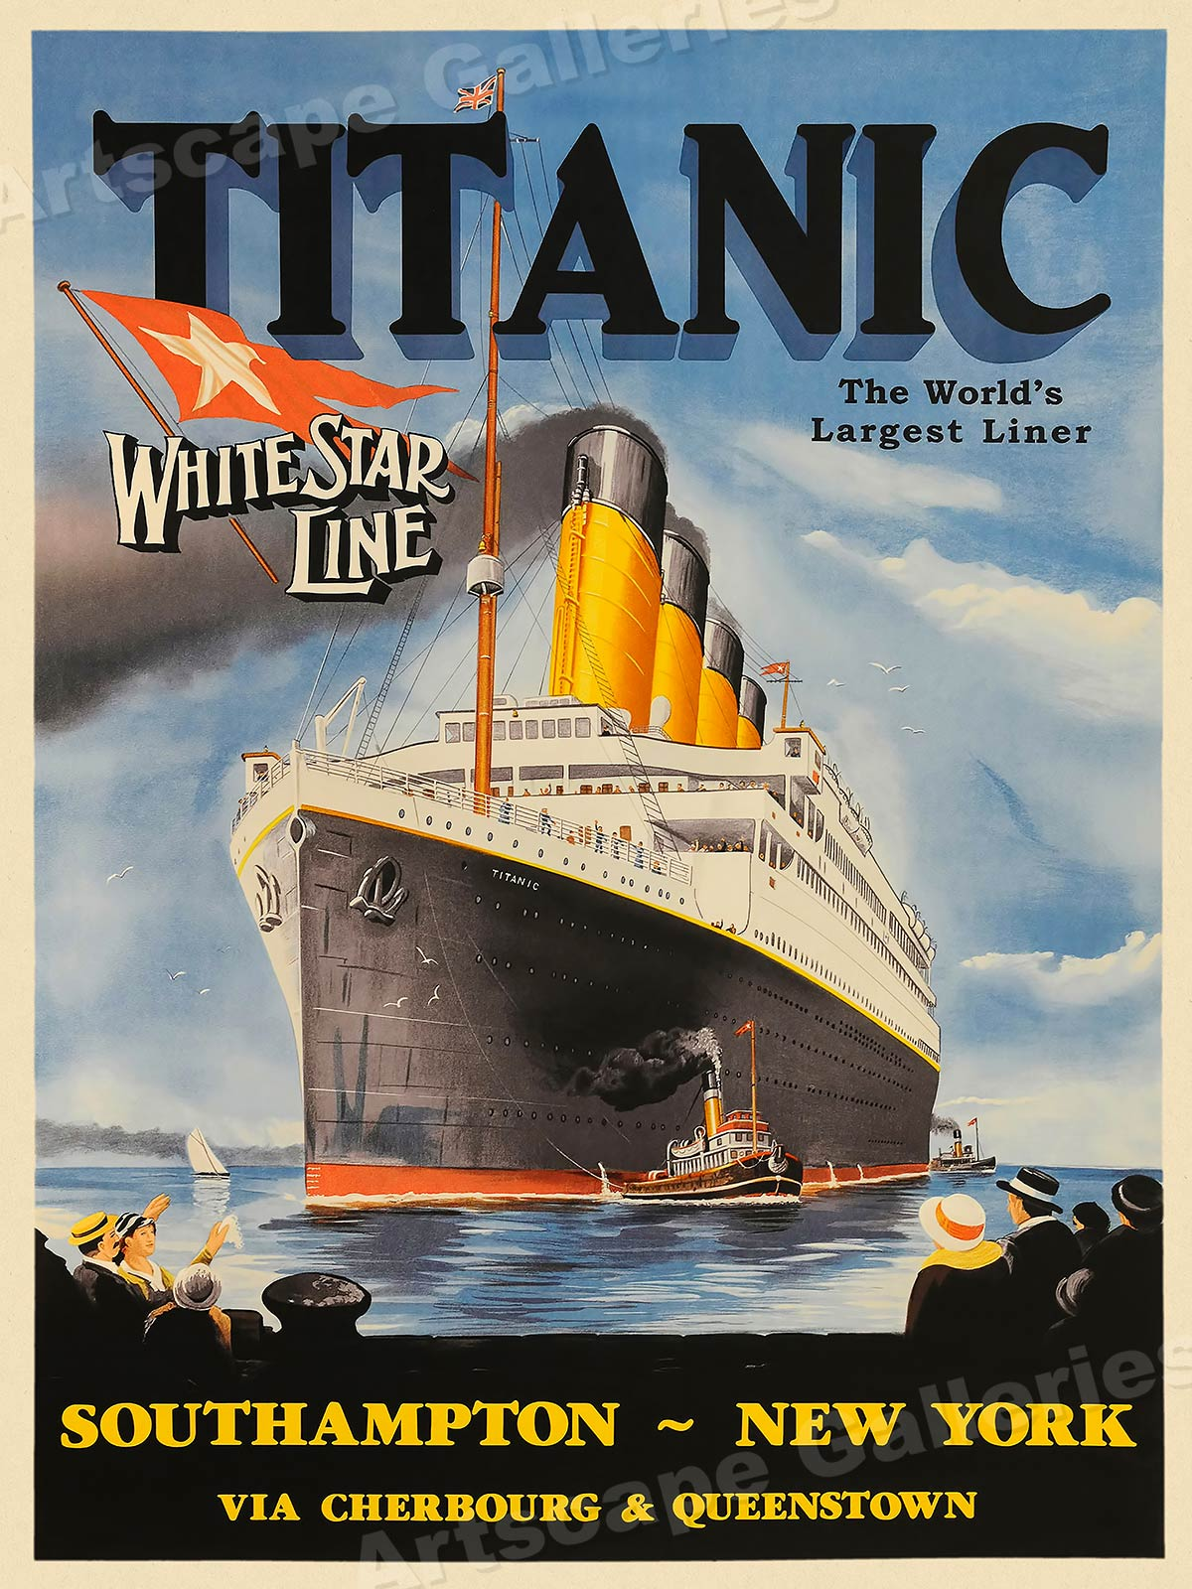

Titanic Data Analysis
Bilqis Lawal – Just IT
26/07/2024

Slide 3
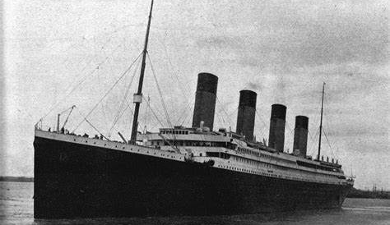


Agenda
INTRODUCTION​
DATA CLEANING/TRANSFORMING​
DATA VISUALISATIONS​ - Python
CORRELATION MATRIX/HEAT MAP​
CONCLUSION​
PREDICTIVE ANALYSIS/REFLECTIONS

Slide 4
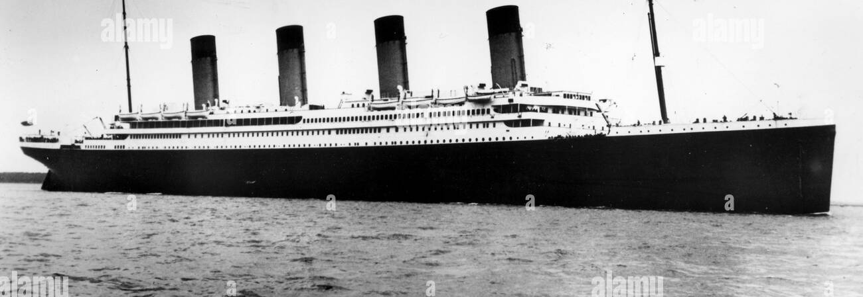
Introduction
The sinking of the RMS Titanic on April 15, 1912, is one of history's most notorious maritime disasters, with over 1,500 of the 2,224 passengers and crew losing their lives. This tragedy highlights the perils of early 20th-century sea travel and the stark class distinctions of that era. Our analysis of the Titanic dataset using Python aims to uncover patterns and insights about passenger demographics and survival rates.

Slide 5





Data Familiarization ​
Data Preparation ​
Coding Tools
Data cleaning ​
Data Transformation ​

Slide 6
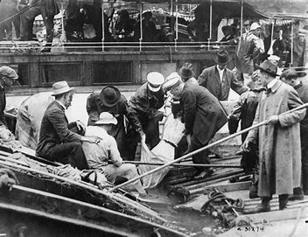
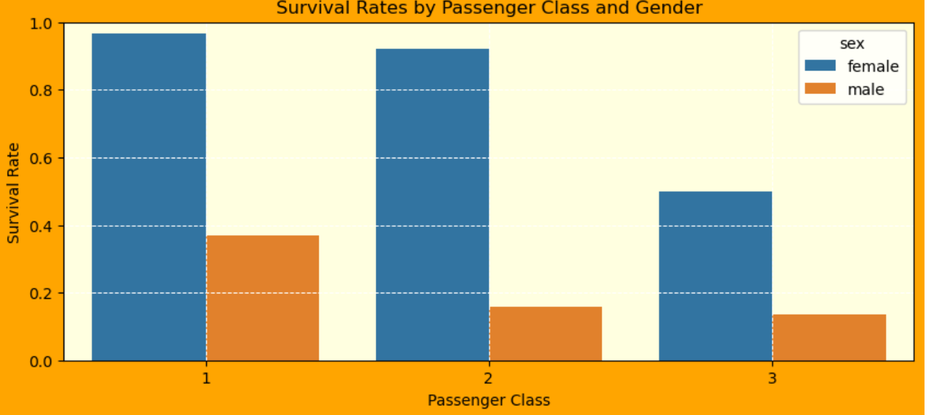
What was the survival rate of passengers by gender and class?
Females had a higher survival rate than males.
Those in first classes had a higher rate of survival than those in 3rd class.
Data Visualisation with MS Excel Tableau and Power BI

Slide 7

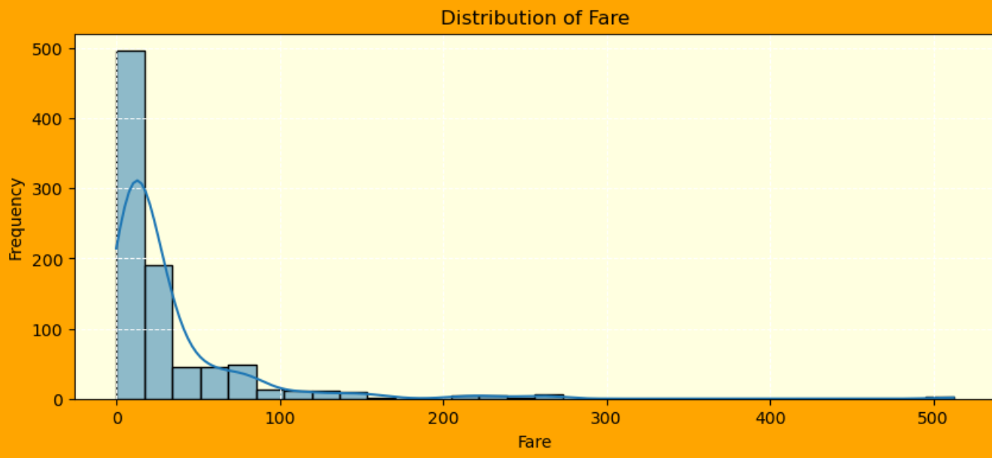
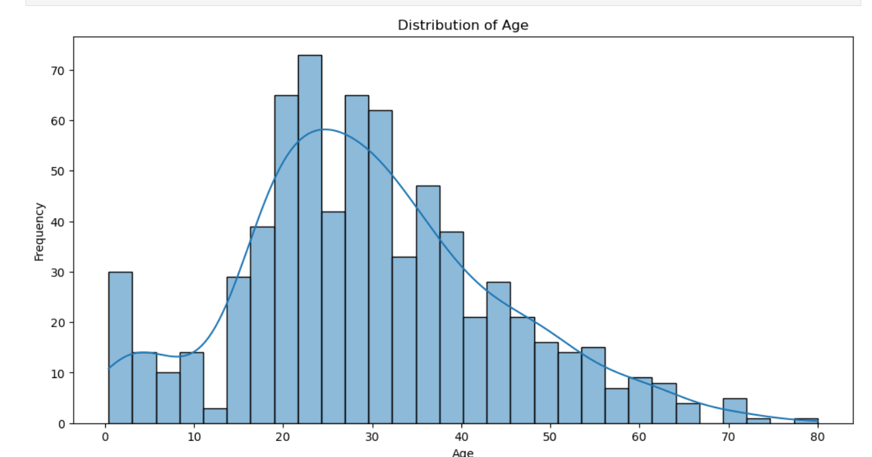
What was the frequency of the distribution of age and fare? And, Is there a relationship?
Suggested that most passengers where between the ages of 20 and 40 years.
In which they paid lower fare
Also suggesting they were in third classes thereby decreasing their survival rate making them the highest rate of passengers that did not survive.

Slide 8
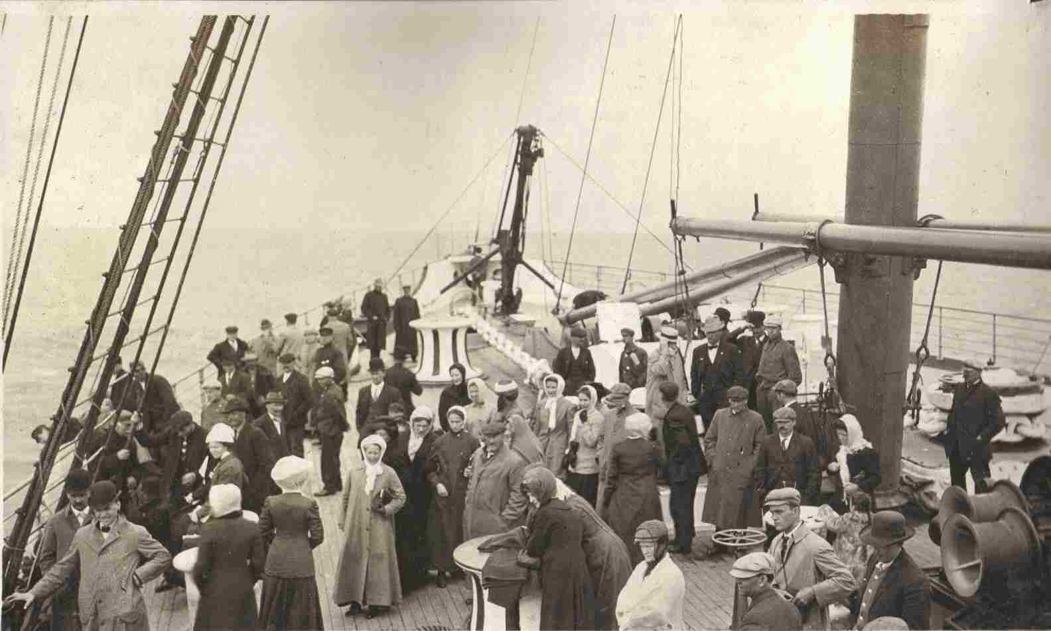
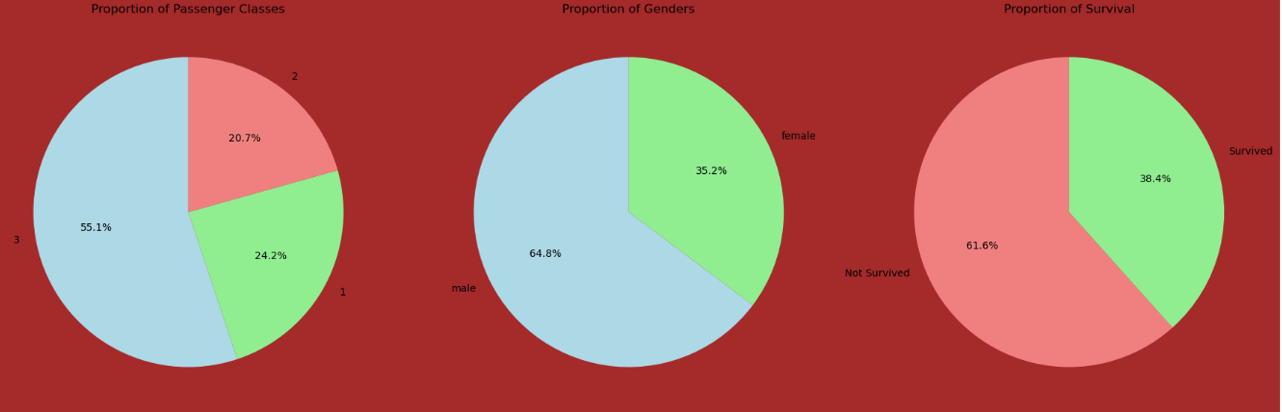
High proportion of 3rd class @ 55.1% High proportion of male @ 64.8% high proportion of non survival rate@ 61.6%
What was the proportion of passenger classes, Gender and Survival rate on board?

Slide 9
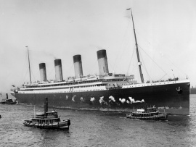
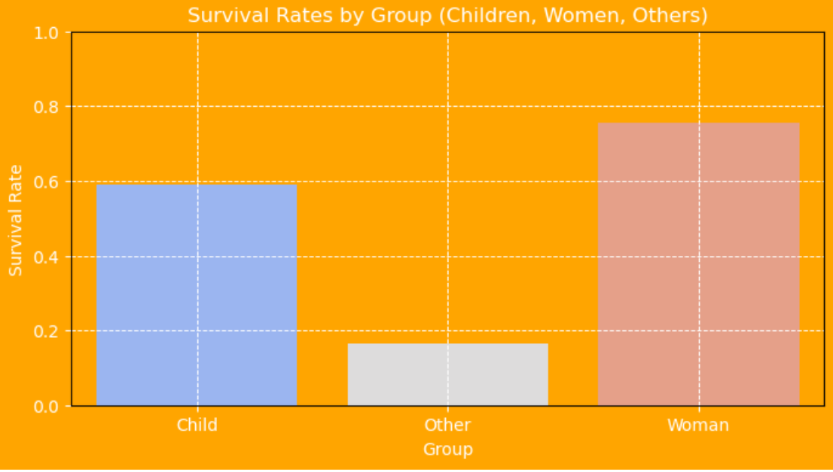
What was the survival rate of children, women and other?
Using the Group by method
Higher survival rate for women than children
Lower survival rate for males

Slide 10
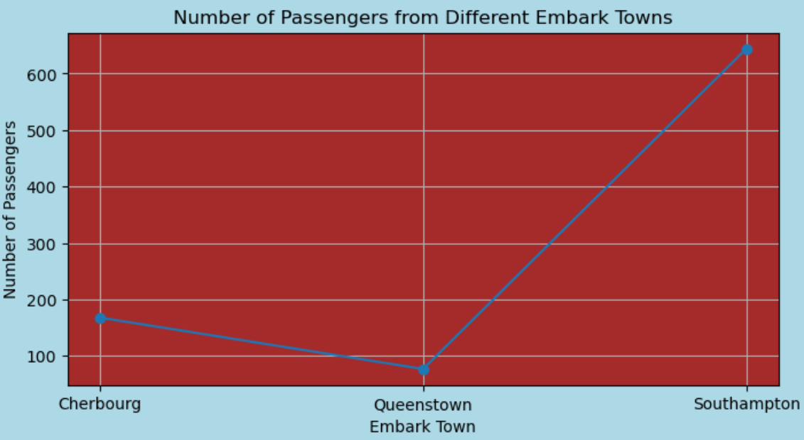
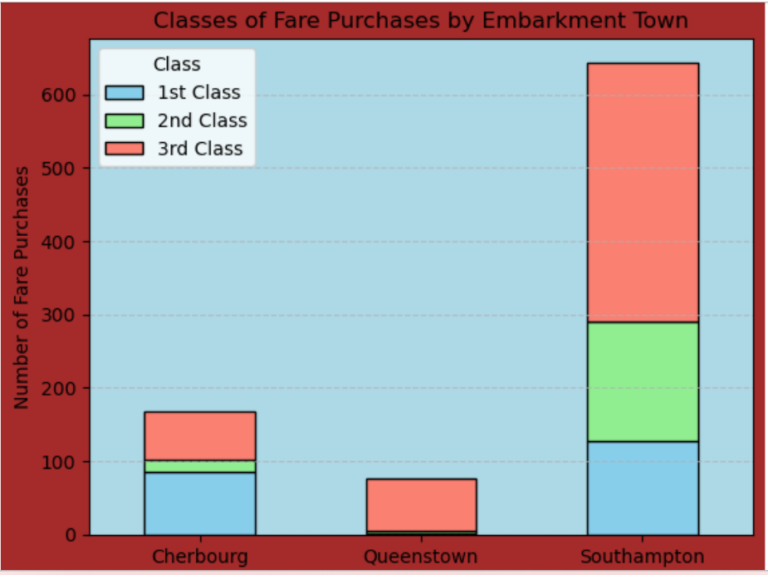
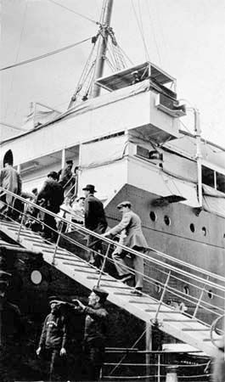
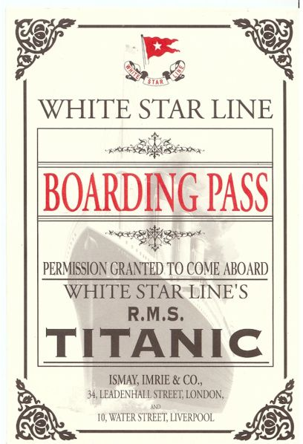
What was the relationship between the Embark Towns, classes and number of fare?
Majority of the passengers on board were from Southampton
Embarkation points were linked to better survival chances

Slide 11

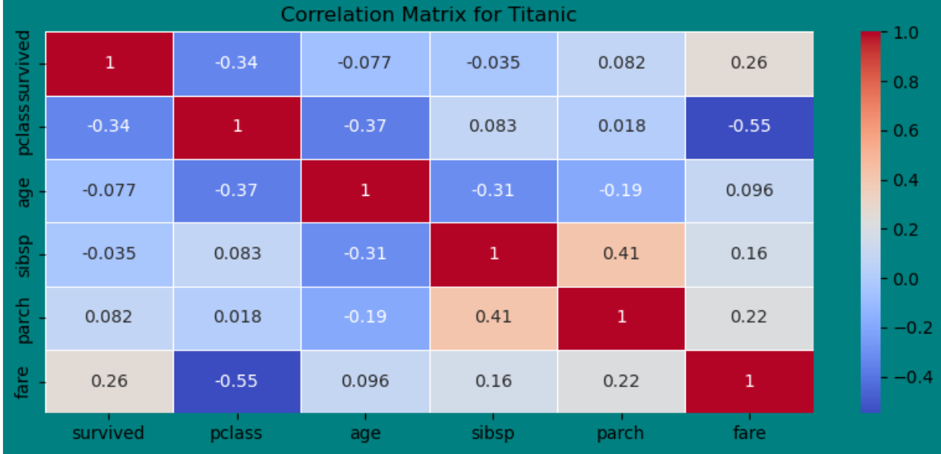
Correlation Analysis - Heat map
What was the correlation between the categories(Survived, Pclass, Age, SibSp, Parch and Fare)?
Survived and Fare: 0.26
Interpretation:
There's a moderate positive correlation between survival and fare.
This indicates that passengers who paid higher fares had a better chance of surviving.

Slide 12
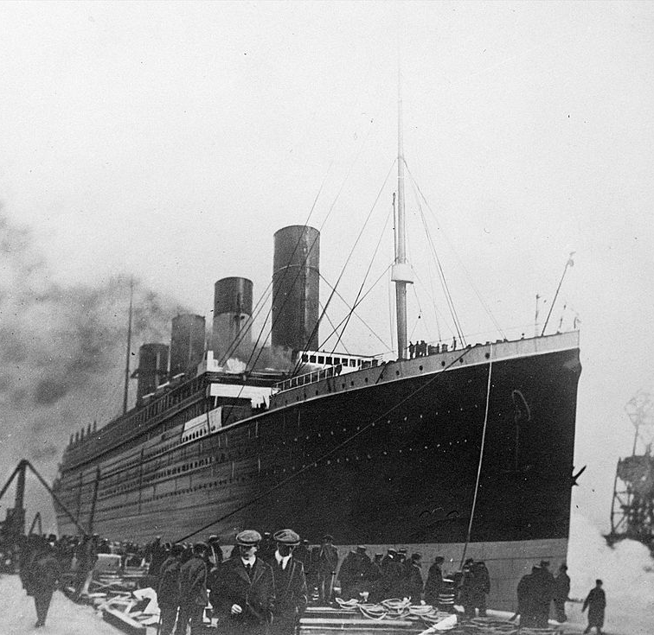
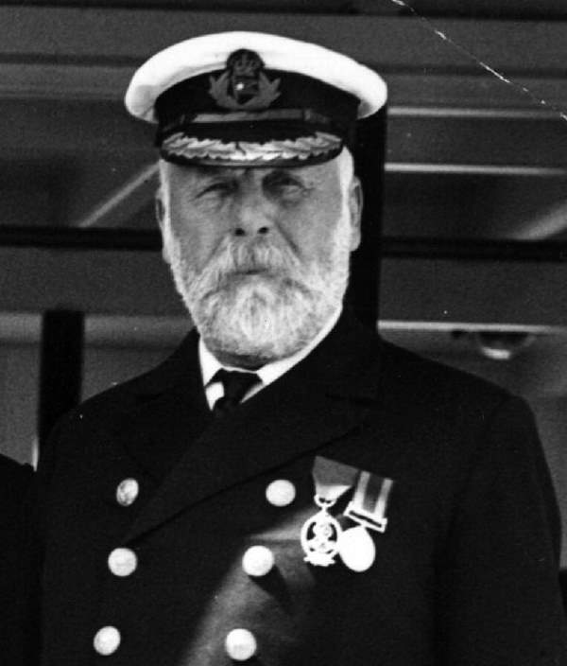
Conclusion
The Titanic dataset analysis reveals that survival rates were higher for women and first-class passengers, underscoring the impact of the "women and children first" policy and better access to lifeboats for higher classes. Despite a minimal effect of age on survival, most victims were males in third class. Higher fares and certain embarkation points were linked to better survival chances, while the presence of siblings or spouses had negligible influence on survival outcomes. This highlights the significant role of class, gender, and fare in determining survival during the disaster.
Captain of Titanic - Edward John Smith

Slide 13

Thank You
Email: qislaw@yahoo.com
LinkendIn : linkedin.com/in/qislaw
Github: https://github.com/qislaw/Data-Analysis-Portfolio
Website: Bilqis Lawal (google.com)

